Slide 1
Weather Effects in the 2018 NFL Season
Team 8
Aaron Hyungbin Woo, Connor Vergara, David Edwards

Slide 2



Methodology
Objective:
A total of 256 games were analyzed to uncover patterns between NFL team performance and weather conditions at game time.
Does temperature affect overall team performance in terms of scoring?
Do kickers perform better when they play indoors? Do they perform worse in poor weather conditions?
Goal:
Our goal is to uncover any type of relationship between team performance and game time weather conditions.
This will involve using the Google Places API, Dark Sky API, and MySportsFeeds API to geocode locations and to gather relevant game and weather data.
Do players fumble more when it’s raining?
Are more points typically scored in certain stadiums?

Slide 3
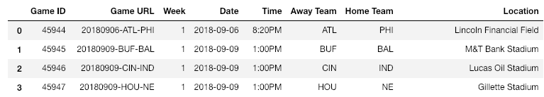
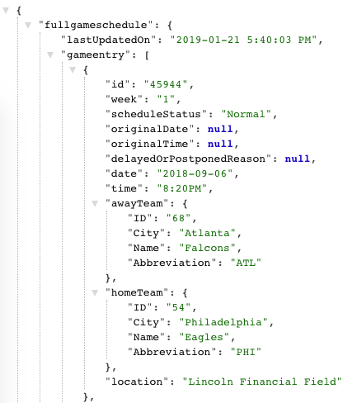
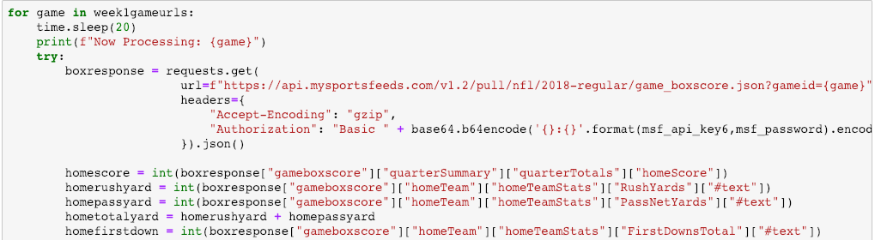
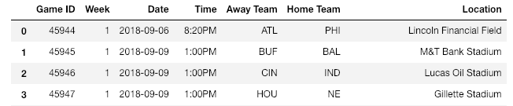
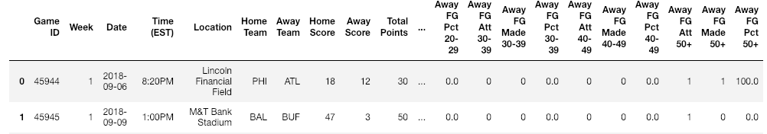
Data Retrieval and Clean Up
We began by building a dataframe that contained every game of the season by using the “Full Game Schedule” feed in the MySportsFeeds API.
Using this data, we then built a “Game URL” field:
To collect the data for each game, we passed the Game URL to the “Game Boxscore” feed in the MySportsFeeds API.

Slide 4
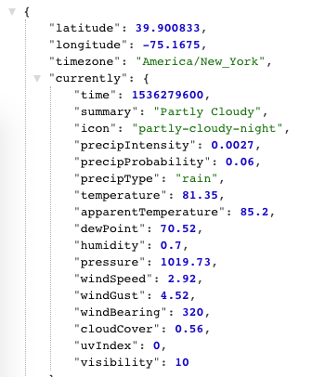
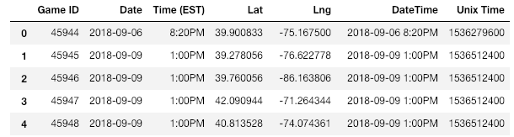
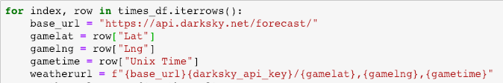
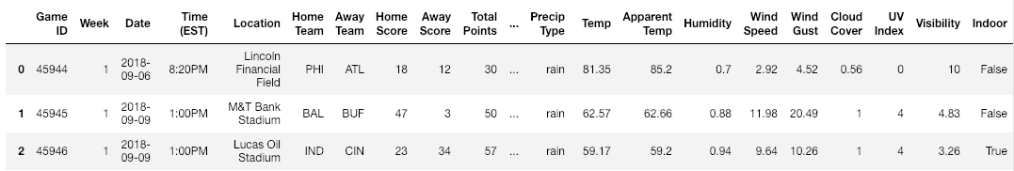
Data Retrieval and Clean Up
Once we had all of our game data, we used a csv file containing stadium data to add the latitude, longitude, and a flag (true/false) for weather the game was played inside. Then, we converted the EST time into Unix time.
Lastly, we pulled in the relevant weather information using Dark Sky and merged the data with our game results to complete our dataframe.
We then created unique URLs to send to our Dark Sky weather API by passing the latitude, longitude, and Unix time.

Slide 5
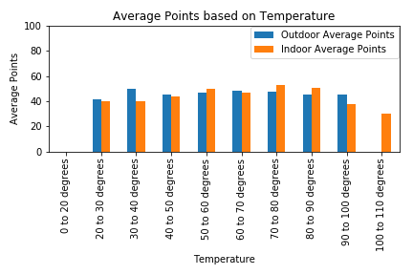
Average Points by Temperature
This data was gathered by appending temperature data gathered by DarkSky API with MySportsFeed API. From there we filtered team scores by Open and Covered Stadiums and plotted the average scores
Open roof stadiums appear to perform slightly better in extreme temperatures in comparison to closed dome stadiums.

Slide 6
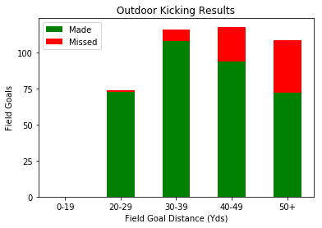
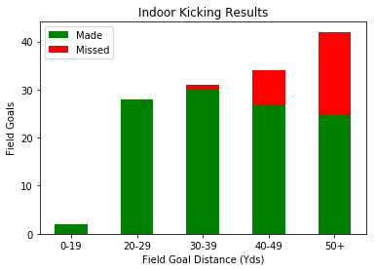
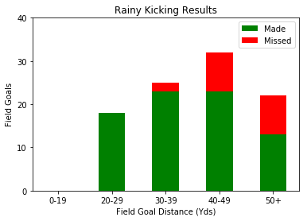
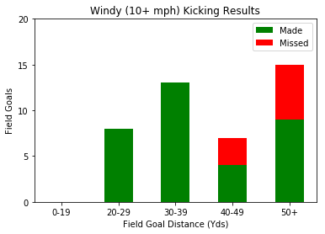
Kicking Results
Our team was curious to see if certain conditions affected kickers and how well they performed. We took a look at four different conditions: Outdoors, Indoors, Rainy, and Windy (10+ mph wind speed).
Playing indoors did not seem to provide a significant advantage to kickers. In fact, the highest percentage of missed kicks were attempts from over 50 yards played in indoor stadiums. Coaches may feel more confident with their kickers when playing indoors, so this may explain this trend.
Rain and wind also appear to be important factors when considering kicking accuracy. Kicks from over 40 yards in rainy or windy conditions were much less likely to be made when compared to the larger sets of outdoor and indoor attempts.

Slide 7
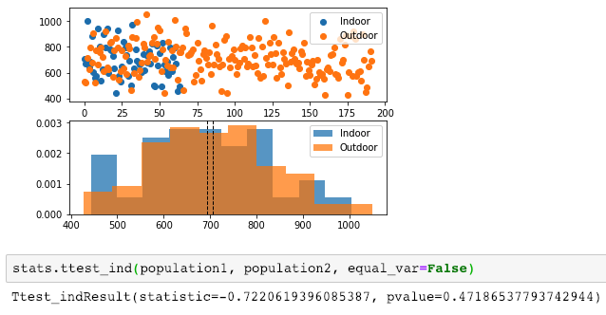
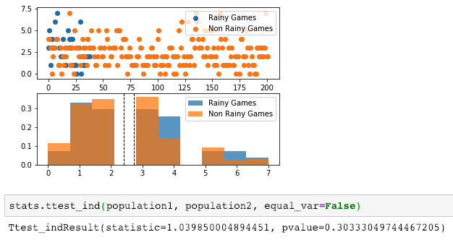
Statistical Testing
Initial analysis of our data revealed that on average, more yards might be gained in games played indoors as opposed to outdoors:
Outdoor Avg. Yards: 693
Indoor Avg. Yards: 707
Is this difference significant? We conducted a two sample t-test to take a deeper look.
While 14 yards may seem substantial, our p-value of ~.47 does not suggest that there’s a significant difference between these two means.
We were also curious to see if players were more likely to fumble in games played in rainy conditions.
Rainy Avg. Fumbles: 2.72
Non Rainy Avg. Fumbles: 2.41
Again, we performed a two sample t-test to test this hypothesis. Our p-value of ~.3 again disproved this hypothesis. However, the lower p-value suggests that the relationship between rainy conditions and fumbles may be stronger than the relationship between indoor/outdoor stadiums and total yards gained in the game.

Slide 8
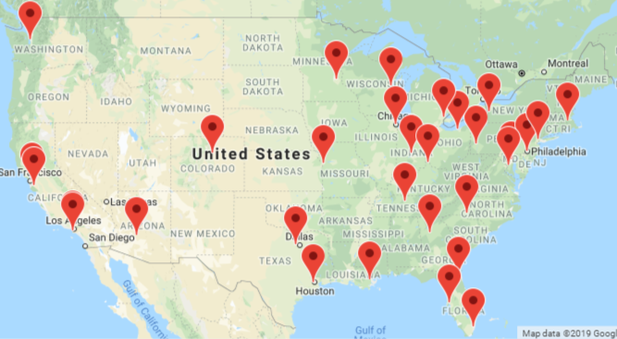
Map of Stadiums
Stadiums
Arrowhead Stadium | Lucas Oil Stadium
AT&T Stadium | M&T Bank Stadium
Bank of America Stadium | Mercedes-Benz Stadium
Broncos Stadium at Mile High | Mercedes-Benz Superdome
CenturyLink Field | MetLife Stadium
Dignity Health Sports Park | New Era Field
FedEx Field | Nissan Stadium
FirstEnergy Stadium | NRG Stadium
Ford Field | Oakland-Alameda County Coliseum
Gillette Stadium | Paul Brown Stadium
Hard Rock Stadium | Raymond James Stadium
Heinz Field | Soldier Field
Lambeau Field | State Farm Stadium
Levi's Stadium | TIAA Bank Field
Lincoln Financial Field | US Bank Stadium
Los Angeles Memorial Coliseum | Wembley Stadium
Stadiums: 32
Stadiums with Open Roofs: 24
Stadiums with Closed Roofs: 8

Slide 9
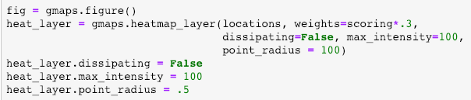
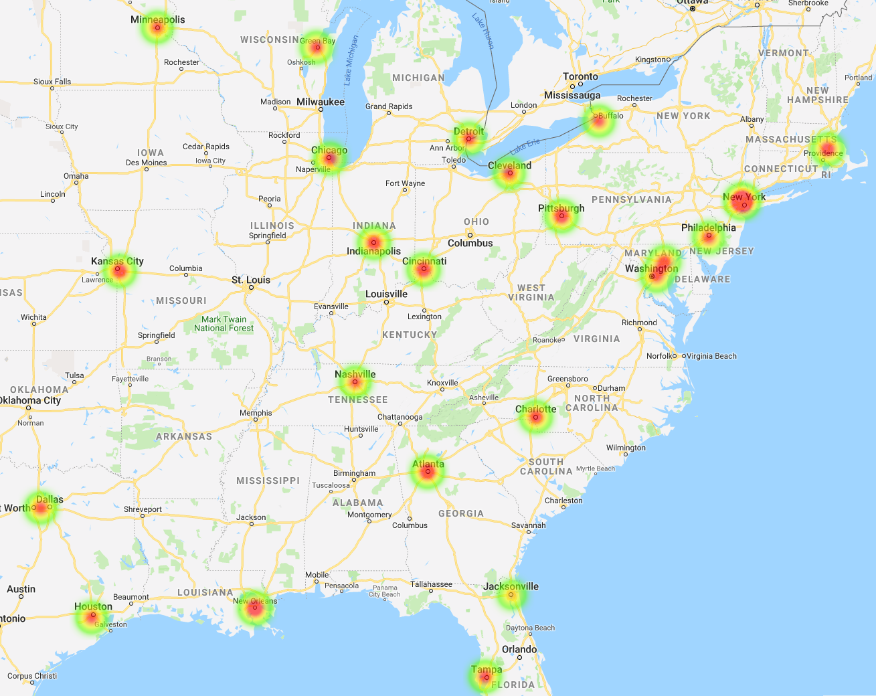
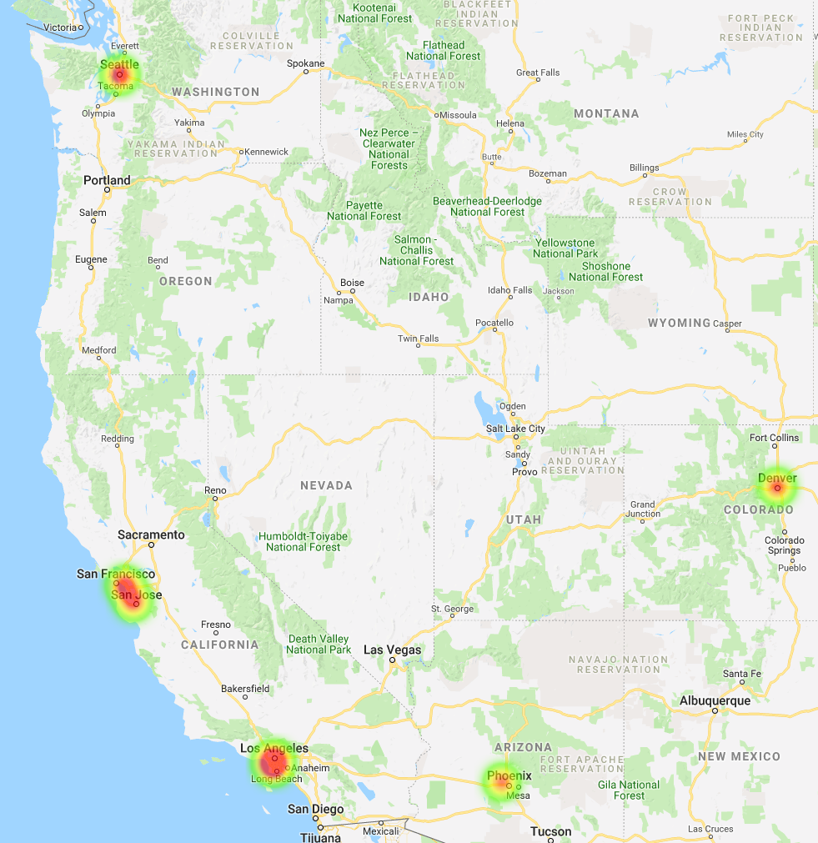
Heatmap of Stadiums
Arrowhead Stadium | Lucas Oil Stadium
AT&T Stadium | M&T Bank Stadium
Bank of America Stadium | Mercedes-Benz Stadium
Broncos Stadium at Mile High | Mercedes-Benz Superdome
CenturyLink Field | MetLife Stadium
Dignity Health Sports Park | New Era Field
FedEx Field | Nissan Stadium
FirstEnergy Stadium | NRG Stadium
Ford Field | Oakland-Alameda County Coliseum
Gillette Stadium | Paul Brown Stadium
Hard Rock Stadium | Raymond James Stadium
Heinz Field | Soldier Field
Lambeau Field | State Farm Stadium
Levi's Stadium | TIAA Bank Field
Lincoln Financial Field | US Bank Stadium
Los Angeles Memorial Coliseum | Wembley Stadium

Slide 10
Overall Findings
Surprisingly, long range kicking accuracy was actually worse in games played in indoor stadiums compared to outdoor stadiums.
In terms of scoring, games played in indoor stadiums were not significantly more likely to have more total points or more total yards than games played outdoors.
Open roof stadiums appear to score more points on average. However, more data from previous seasons would help prove or disprove this assumption.
Explaining scoring patterns is difficult – a variety of factors come into play, some of which are related to weather. However, scoring patterns are most likely attributed to the teams and players on the field, and not the conditions of the specific game.

Slide 11
Difficulties and Challenges
Sending too many requests to the MySportsFeed API. To combat this, we created a total of 6 unique API keys and cycled through them when pulling our game data.
Finding errors in the game data (locations in particular) and making manual changes to our dataframe.
Using the .get() function to attempt to retrieve data, and if the data is missing, replace with a default value.
Converting time formats pulled from one data to another.
Missing significant historical data (only 2018 regular season) limited the team in making additional findings of significance.
Limitations of precise data for certain stats did not allow for more detailed game analysis.
Weather data was pulled at the start of the game, so any changes to weather throughout the game were not accounted for.

Slide 12
Questions?

